Slide 1

Introduction to Python for Data Analysis
Welcome! This presentation will provide an overview of Python's fundamental features and how they can be used to analyze data. Python is a versatile and powerful language that has become increasingly popular for data analysis, thanks to its simplicity, readability, and extensive libraries.

Slide 2
Python Fundamentals
Variables and Data Types
Operators
Input and Output
Variables store data of different types. We'll cover basic types like integers, floats, strings, and booleans.
Operators perform operations on variables. We'll discuss arithmetic, comparison, logical, and assignment operators.
Learn to take input from users and display output. We'll explore using functions like `input()` and `print()`.

Slide 3
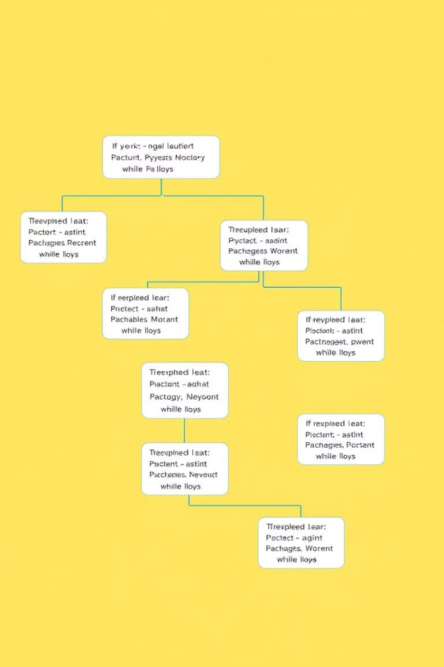
Conditional and Looping Statements
1
Conditional Statements
2
Looping Statements
Repeat code blocks multiple times. We'll explore `for` and `while` loops for iterating over data.
Execute different code blocks based on conditions. We'll examine `if`, `elif`, and `else` statements.

Slide 4
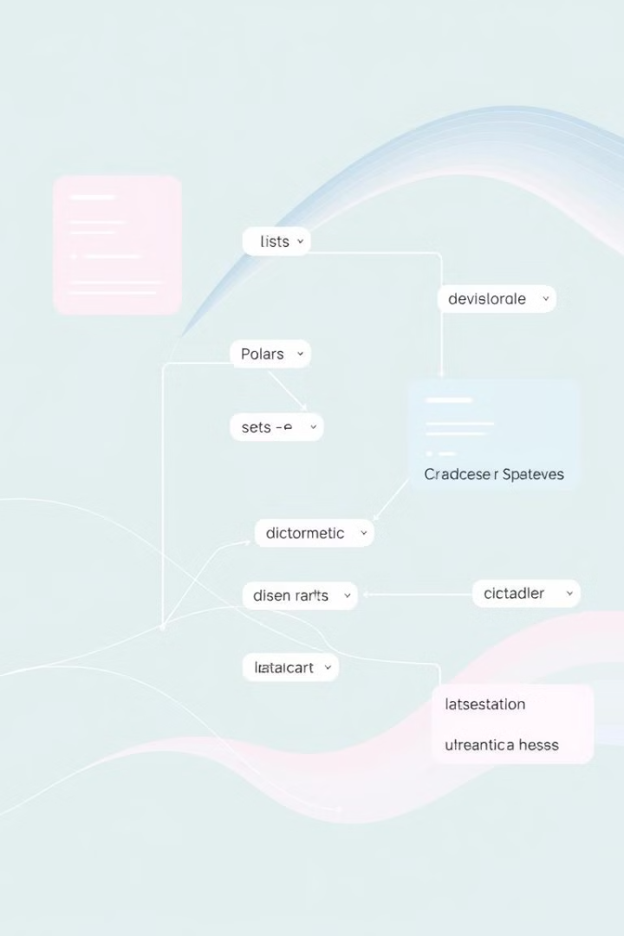
Data Structures
Lists
Dictionaries
Ordered collections of elements, mutable, and can store different data types.
Unordered key-value pairs, efficient for lookups, and keys must be unique.
Tuples
Sets
Ordered collections of elements, immutable, and can store different data types.
Unordered collections of unique elements, mutable, and useful for removing duplicates.

Slide 5
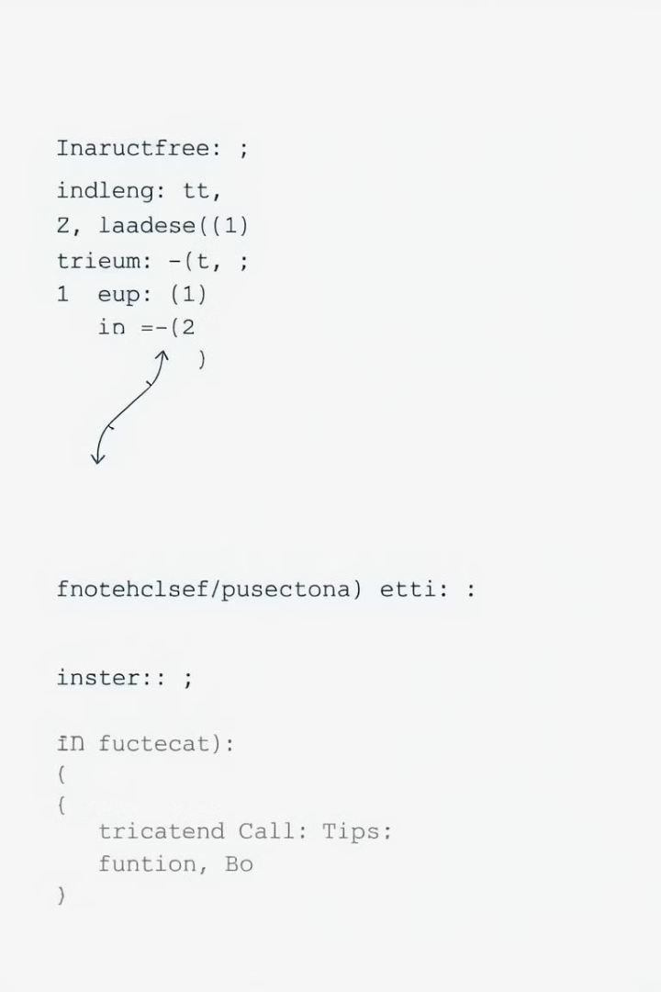


Functions
Defining Functions
Create reusable blocks of code that perform specific tasks. We'll cover function arguments and return values.
Calling Functions
Execute functions with arguments. We'll explore how function calls work and their benefits.

Slide 6



File and Exception Handling
File Handling
Exception Handling
Work with files, opening, reading, writing, and closing them. We'll discuss file modes and file operations.
Manage errors during program execution. We'll learn how to handle exceptions using `try`, `except`, and `finally` blocks.

Slide 7




Object-Oriented Programming (OOPs) Concepts
Classes
1
Blueprints for creating objects with attributes (data) and methods (functions).
Objects
2
Instances of classes with specific values for attributes.
Inheritance
3
Creating new classes that inherit attributes and methods from parent classes.
Encapsulation
4
Bundling data and methods within classes to protect and manage access.

Slide 8

Conclusion and Key Takeaways
Congratulations! You've learned the foundational elements of Python for data analysis. Remember to practice regularly to strengthen your skills. Python offers a wealth of libraries and tools specifically designed for data science.

